Slide 1
Small Business and International Entrepreneurship： Overcoming Barriers and Finding Opportunities
Multinational Management
耿延

Slide 2
Learning Objectives (1 of 2)
Understand the basic definitions of small business and entrepreneurship.
Explain how small businesses can begin as global start-ups or follow the stages of internationalization.
Understand how small businesses can overcome barriers to internationalization.
Identify when a small business or entrepreneurs should consider going international.

Slide 3
Learning Objectives (2 of 2)
Describe how small businesses or entrepreneurs can find customers, partners, or distributors aboard.
Understand how new venture wedge strategies can be used in foreign markets.
Explain the factors driving entrepreneurship at an international level.

Slide 4
What Is a Small Business? (1 of 2)
“Small” businesses:
  Constitute over 98% of businesses in Europe, North America, and Japan
  Employ more than 50% of their local populations
  Produce nearly 50% of these countries’ GNPs
  Create more than 2/3 of new jobs in the US

Slide 5
What Is a Small Business? (2 of 2)
The term “Small” business is variously defined. The small business has:
  UN & OECD: less than 500 employees
  The popular press: less than 100 employees
  US Small Business Administration:
    Definition varies by industry
    Uses both sales revenue and the number of people

Slide 6
Internationalization and the Small Business
Two models:
  Small business stage model: process of following incremental stages of internationalization
  Global start-up or Born-global firm: company that begins as a multinational company

Slide 7
Small Business Stage Model: Six Stages (1 of 2)
Stage 1: Passive exporting
  Firm fills international orders but does not seek export business. Does not realize it has an international market.
Stage 2: Export management
  Specifically seeks exports, usually relying on indirect exporting due to resource limitations. Major orientation change for the firm: Exporting is seen as an opportunity.
Stage 3. Export department
  Significant resources dedicated to seeking increased sales from exporting. No longer see exporting as a prohibitive risk. Key is to find good local partner for distribution.

Slide 8
Small Business Stage Model: Six Stages (2 of 2)
Stage 4: Sales branches
  High demand justifies setting up local sales office. Must have resources to transfer manager or hire local managers
Stage 5: Production abroad
  Firm moves beyond downstream activities; uses licensing, joint ventures or direct investment. This is a difficult stage because failure may put whole firm at risk.
Stage 6: The transnational
  Its small size does not prevent the firm from developing a global integrated network.

Slide 9
Small Business Global Start-ups or Born-Global Firms
Companies begin as multinationals; they must pursue a global vision from inception and globalize rapidly.
Born-globals are critical to the international business environment.
Threat to traditional multinationals: Very flexible, fast moving, knowledge intensive; introduce innovations.
Global start ups are riskier than domestic startups.
Yet, they offer an avenue for new venture success in rapidly globalizing industries.

Slide 10
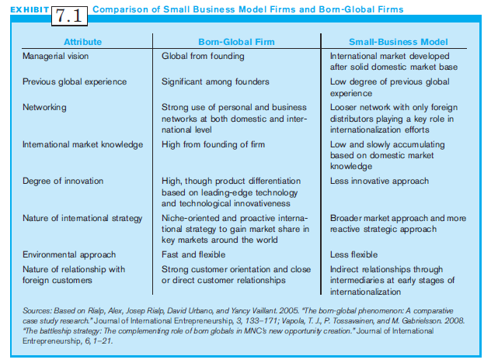
Exhibit 7.1:
Comparison of Small Business Model Firms & Born-Global Firms

Slide 11
Small Business E-Commerce
Technology has leveled the playing field for small firms.
The internet offers a rapid way to go international.
A web site configured for e-commerce is a low cost and quick way to sell across national borders.

Slide 12
Advantages of
Small Business E-Commerce
Ability of small firms to compete locally, nationally and internationally
Possibility and opportunity for more diverse people to start a business
Convenient and easy way of doing business 24 hours a day, 7 days a week
Inexpensive way to compete with larger businesses
Makes domestic products available in other countries
However, psychological and resource barriers remain.

Slide 13
Overcoming Small Business Barriers to Internationalization (1 of 2)
Small size barriers include:
  Limited financial and personnel resources to dedicate to international operations
  Lack of sufficient scale to produce goods efficiently
  Top managers with limited international experience, or negative attitudes, viewing them as being too risky
  Organizational cultures with strong domestic orientation
  Contextual and environmental issues that magnify difficulties in international operations

Slide 14
Overcoming Small Business Barriers to Internationalization (2 of 2)
Overcome small business barriers to internationalization by:
  Developing a small business global culture
  Changing attitudes of key decision makers
  Gaining experience
  Overcoming size limitations
  Using the small business advantage

Slide 15
Developing a Small Business Global Culture
Global culture is achieved when managers and workers value view strategic opportunities as global and not just domestic.
Workers share common language to describe international operations at all levels.
Develop a framework to understand international operations.
Develop an international mindset.
Global thinking: Do business and conduct value chain operations anywhere in the world.

Slide 16
Characteristics of Key Decision Makers
Characteristics of decision makers affecting development of a global culture
  Perceived psychological distance to foreign markets
  International experience
  Risk aversion
  Overall attitudes toward international strategies

Slide 17
Changing Attitudes of
Key Decision Makers
How to change attitudes of key decision makers:
  Begin with sales to countries close in culture and geography
  Experience and success overcome skepticism regarding the international markets.
  Eventually, foreign markets perceived as more profitable than domestic.
But positive attitudes crucial for global start-ups from beginning.

Slide 18
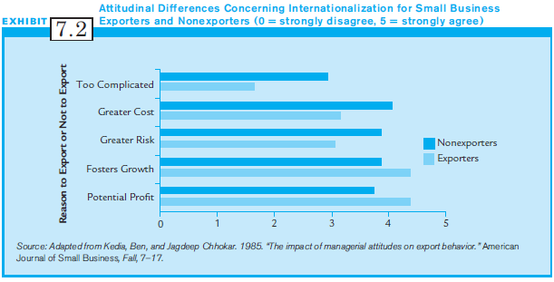
Exhibit 7.2:
Attitudinal Differences Concerning Internationalization for Small Business

Slide 19
Gaining Experience:
Duties and the Personal Life of the Small Business CEO
Internationalization affects personal life and company duties of the CEO more than workers.
For small firm, opening new markets is CEO’s time-consuming and challenging personal responsibility.
The CEO must bear social and business costs:
  Increased travel, stress from undertaking a new venture, can adversely affect family life, risk whole business.
  Job restructuring, retraining, new skills for international business requirements .

Slide 20
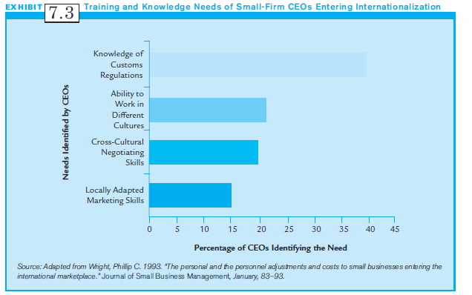
Exhibit 7.3:
Training and Knowledge Needs of Small Firm CEOs Entering Internationalization

Slide 21
Is Size a Barrier for Small Business Internationalization?
Liabilities of smallness: challenges facing small businesses in the resources necessary to internationalize
Large firms serve more national markets, have access to resources, can negotiate with geographically dispersed partners, & invest in cross cultural training.
Small firms lack scale to produce goods or services as efficiently as larger companies, and absorb risks.
Size liabilities, however, may exist only in the initial internationalization stage.

Slide 22
Using the
Small Business Advantage
Speed becomes the small business advantage:
  Faster innovation
  Can change products and internal operations faster
  Speed can overcome size disadvantages
  Larger firms must often overcome bureaucratic procedures, slow to take advantage of new markets
  First to market allows capture of market share before larger companies can react.

Slide 23
The Future: Falling Barriers to
Multinational Small Businesses
Government programs to support small businesses are expanding.
High impact trade agreements (NAFTA, WTO) make trade less complex and reduce resource requirements.
Growth in international business information available on Internet makes knowledge easily available to small businesses.
Such knowledge encourages entrepreneurs to consider going global.

Slide 24
When Should a Small Business Go International? (1 of 2)
A small business that answers “yes” to these questions may be ready to go global:
  Do we have a global product or service?
  Do we have the managerial, organizational, and financial resources to internationalize?
  Are we willing to commit resources to face the risks of internationalization?
  Is there a country in which we feel comfortable doing business?

Slide 25
When Should a Small Business Go International? (2 of 2)
A small business that answers "yes” to these questions may be ready to go global (cont’d):
  Is there a profitable market for our product or service?
  Which country should we enter?
  Do we have a unique product or service that is not easily copied by large multinationals or local entrepreneurs?
  Do location advantages exist upstream in the value chain?
  Can we afford not to be a multinational?

Slide 26
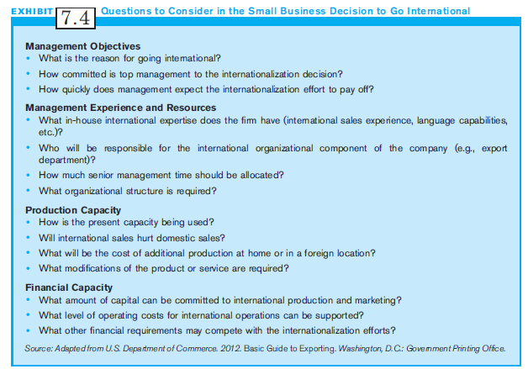
Exhibit 7.4:
Questions to Consider in the Small Business Decision to Go International

Slide 27
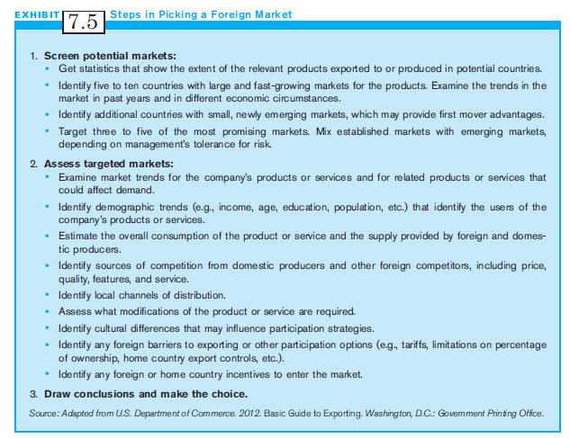
Exhibit 7.5
Steps in Picking a Foreign Market

Slide 28
Getting Connected to the International Market
Participation strategies:
  Same participation options as larger firms
  Exporting, licensing, joint ventures, and foreign direct investment
  Most small businesses choose exporting, and use services of ETCs or EMCs to get their product to international markets

Slide 29
Finding Customers and Partners: Customer Contact Techniques
Customer Contact Techniques include:
  Trade shows
  Catalog expositions
  International advertising agencies & consulting firms
  Government-sponsored trade missions
  Direct contact

Slide 30
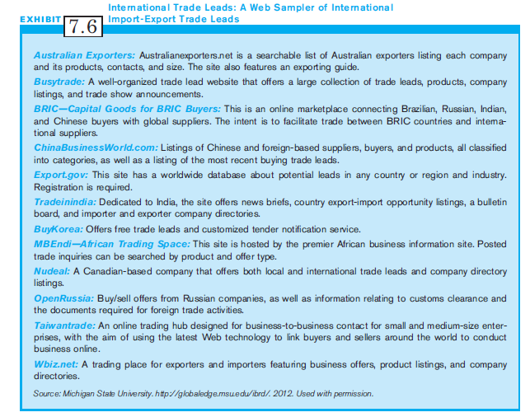
Exhibit 7.6:
International Trade Leads:
A Web Sampler

Slide 31
Ready to Go and Connected: A Synopsis (1 of 2)
Ask the diagnostic questions on readiness for internationalization.
Focus on whether the small firm has the right products and adequate resources
Then consider the competition & countries where it might do business.
If the firm is ready & opportunity exists, there are several mechanisms to make customer & partner contacts.

Slide 32
Ready to Go and Connected: A Synopsis (2 of 2)
Detailed research will reveal more sources, and increase the likelihood of international success.
Finding the right overseas partner may be most crucial.
Even if this is the right company, right product, and potential customer, the small firm still needs a wedge to break into a new market.
Small firms can use traditional entrepreneurial wedge strategies.

Slide 33
New-Venture Strategies for
Small Multinational Companies
Entry Wedge: a strategic competitive advantage for breaking into the established pattern of commercial activity:
  New Product or Service and First Mover Advantage
  Copycat Businesses

Slide 34
New Product or Service and First-Mover Advantage (1 of 2)
First-Mover Advantage: Being the first to introduce a product or service:
  Product or service must be innovative and comprehensive.
    Comprehensive: Must meet customer expectations in areas such as warranty, customer service & expected components. Without these, its easy for competitors to imitate.
Technological leadership: being first to use or introduce a new technology; most common source of advantage; gives a head start for further innovations

Slide 35
New Product or Service and First-Mover Advantage (2 of 2)
Advantages of being First-Mover:
  Have first access to natural and social resources.
    Can choose the best locations for resources, proximity to customers
  Have the best access to social relationships
    Leads to personal contacts to build effective channels of distribution , & to build trust & commitment
  Reduce switching costs which a customer incurs when going to a competitor’s product (Apple v Windows)

Slide 36
Copycat Business
Copycat Business: Adopts existing products or services
  A copycat business follows the “me too” strategy.
  Competitive advantage comes from varying the nature of a product or service, or how the firm provides the product or service.
  Successful copycats do not copy existing business identically.
  They find a niche or slight innovation to attract customers.

Slide 37
Successful Copycat Moves
Successful Copycat moves include these:
  Be the first to change to a new standard.
  Go after the toughest customers.
  Play to minor differences in customer needs.
  Transfer the location.
  Become a dedicated supplier or distributor.
  Seek abandoned or ignored markets.
  Acquire existing business.

Slide 38
International Entrepreneurship
(1 of 4)
Entrepreneur: A person who creates new ventures that seek profit and growth
  The entrepreneur faces risks and the uncertainty of new and untested business
New Ventures: exist when:
  a firm enters a new market, or
  offer a new product or services, or
  introduces a new method, technology or innovative use of raw materials

Slide 39
International Entrepreneurship
(2 of 4)
International Entrepreneurship: The “discovery, evaluation and exploitation of international market opportunities.”
Most experts consider entrepreneurship the driving force of small business.
Without the entrepreneurial spirit, few small businesses would exist anywhere in the world.

Slide 40
International Entrepreneurship
(3 of 4)
If we want to fully understand the small businesses in any nation, we need to examine the level of entrepreneurship there.
Entrepreneurship is the driver of innovation and economic development anywhere.
In a country context which allows entrepreneurial activities to flourish, rapid industrialization occurs.
Entrepreneurship not only creates new jobs but also generates new wealth and growth.

Slide 41
International Entrepreneurship
(4 of 4)
Many multinational firms rely on entrepreneurs and small businesses to do business when entering a new country.
Small businesses can often provide critical products or services, thereby facilitating entry.
Small businesses can assist MNCs in offering or developing new products.
MNCs’ location decisions are often based on level of entrepreneurship existing in the country of choice.

Slide 42
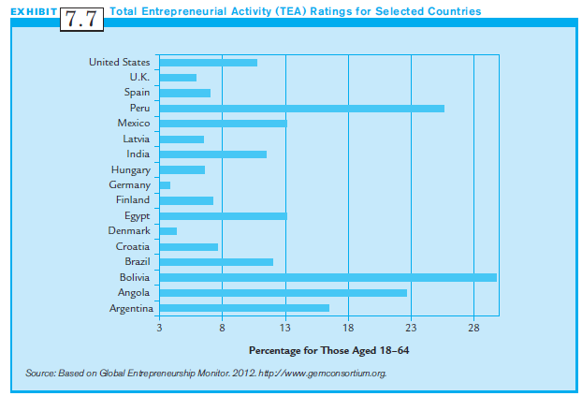
Exhibit 7.7:
Total Entrepreneurial Activity (TEA) for Selected Countries

Slide 43
Summary
We discussed crucial background information on small businesses, and also discussed international entrepreneurship.
Small businesses are important aspects of economies of all nations.
Small businesses often provide the most jobs, economic growth and the best innovation.
The world offers opportunities and challenges for international small business and entrepreneurship.

